Slide 1
Finding Location for New Fitness Studio in
Hamburg, Germany
Kadir Karatas
26.07.2020

Slide 2
Introduction - Opening new fitness studio in Hamburg, Germany - It is very popular to go fitness studios build muscles. - It is a trending business to open fitness studios.

Slide 3
Data Description - For areas and regions of Hamburg https://de.wikipedia.org/wiki/Liste_der_Bezirke_und_Stadtteile_Hamburgs - For latitude and longitude the geolocator function - For the fitness studio location I am going to use Foursquare data.

Slide 4
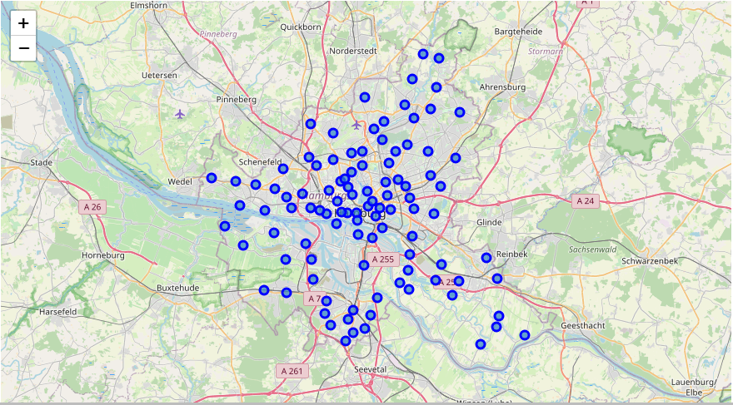
Methodolody: Hamburg’s Potential Areas

Slide 5
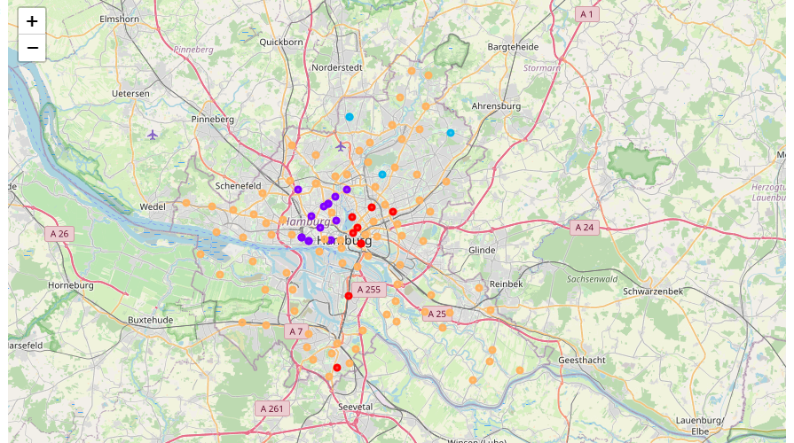
Methodolody: Hamburg’s Clustered Areas ( Orange are high potential)

Slide 6
Results - Openning fitness studios on the orange colored areas. - the dark blue areas are, as expected, full with fitness studios, while being city center. - Red and light blue areas also seem having relative high numbers of fitness studio.

Slide 7
Discussion When we evaluate the results, we have to consider the reliability of the veneu data. As a person living Hamburg, the number of fitness studio in Hamburg should be around 27. However, the results have reasonability while the density of fitness studios are increasing in the city center

